Slide 1
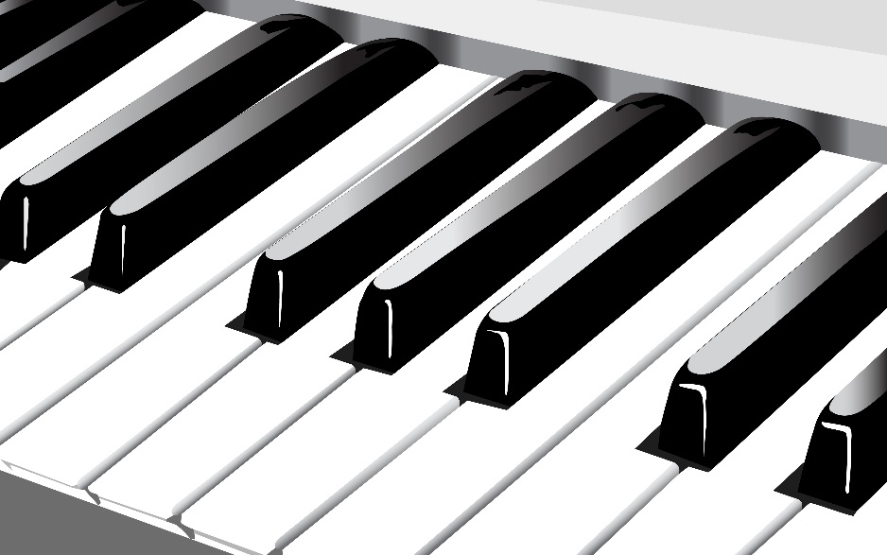
New Age Music
Descriptive Elements

Slide 2
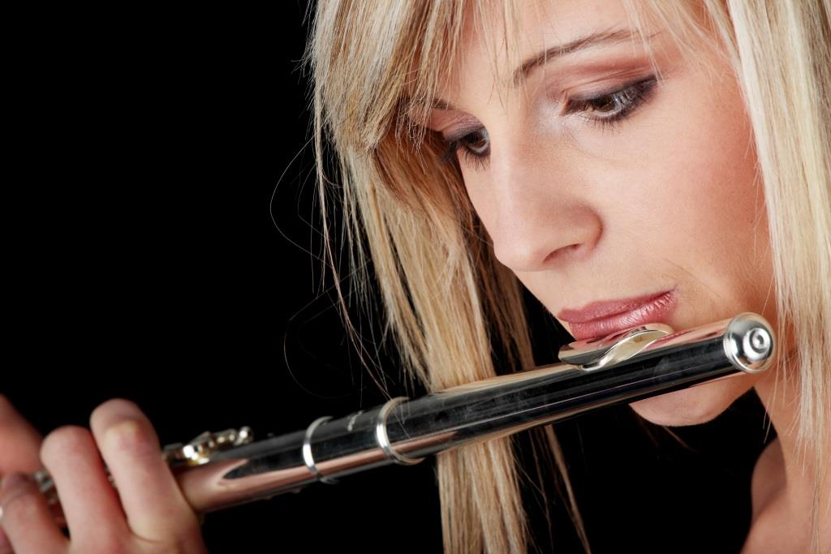
Style
Melodic
Electronic
Soothing
Spiritual
Contemplative
Relaxing

Slide 3
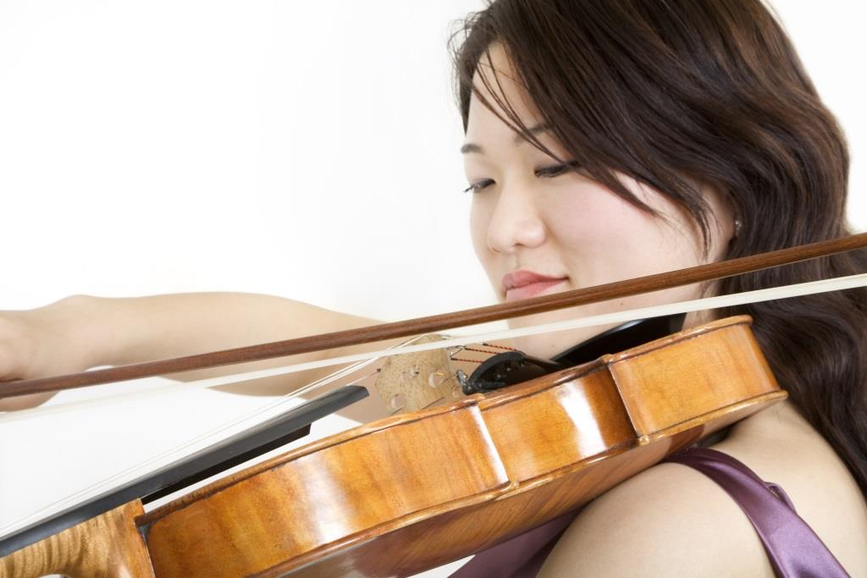
Characteristics
Primarily Instrumental
Simple Sounds
Gentle Melodies
Long Tracks

Slide 4
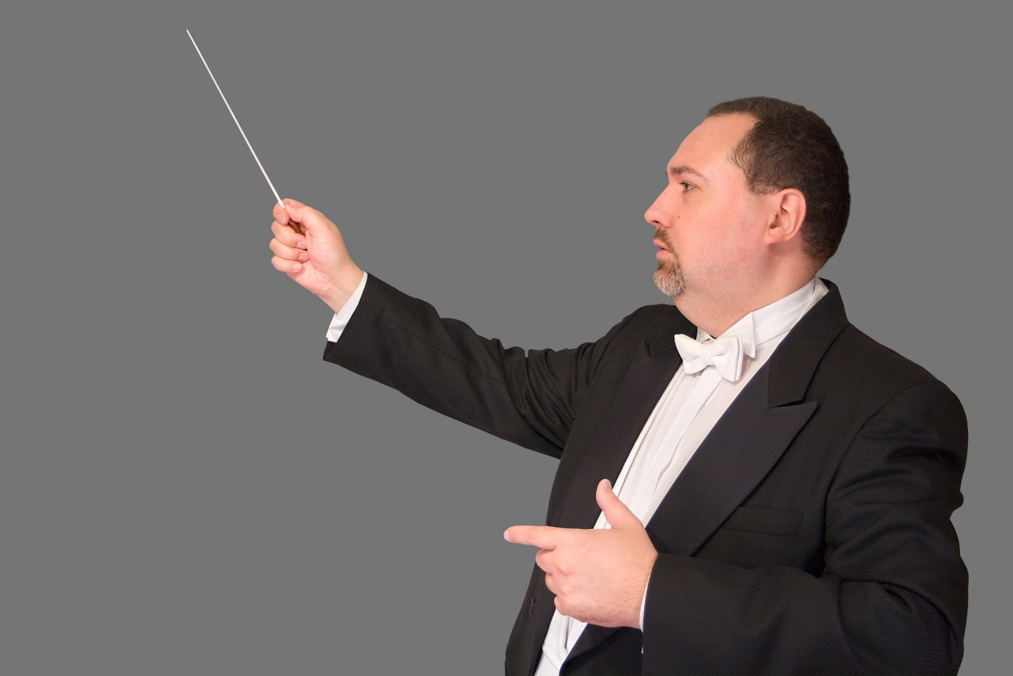
Functions
Reflection
Contemplation
Reading
Thinking
Meditation

Slide 5

Avoids
Heavy Rhythms
Harsh Sounds
Complex Harmonies
Virtuosic Display

